Slide 1


-Butterfly Classification using Transfer Learning-
Batch No: 12
Bharathwaj M (RA2011026020065)
Harshit V (RA2011026020086)

Slide 2
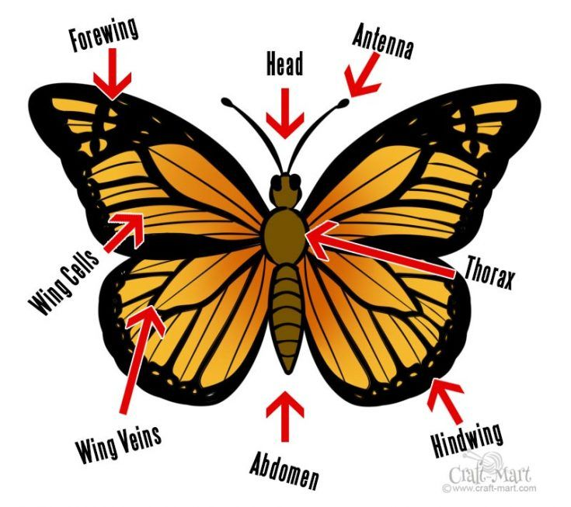
- Problem Statement -
The patterns of butterﬂies are essential features for researchers and people who are interested in categorizing butterﬂies.
However, it is difficult to classify butterﬂies based on biological patterns, such as
Shapes,
Wing colors and
Veins
Currently, researchers rely mostly on time-consuming processes dealing with manually identifying and classifying by highly trained individuals.
Therefore, to tackle, there is a need for modern and automated technologies in dealing with species identiﬁcation with good accuracy.

Slide 3
- Abstract -
The objective is to develop an application can detect the category of a butterﬂy by either capturing a real-time picture of a butterﬂy or choosing one picture from gallery.
We evaluated traditional deep learning and transfer learning methodologies by training and testing on a butterﬂy dataset, and determine the optimal model.
This project uses ResNet-50 (It is pretrained model convolutional neural network that is 50 layers deep) to train the model by the method of transfer learning .

Slide 4
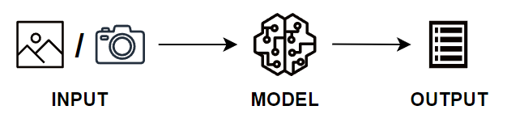
- Objective -
The objective is to develop an application can detect the category of a butterﬂy by either capturing a real-time picture of a butterﬂy or choosing one picture from gallery.
Finally this will be made as an Web App with clean UI/ UX and additionally Open AI’s GPT will be implemented for getting the information about the predicted butterfly species.

Slide 5
- Existing System -
CNN WITH 4 CONVOLUTIONAL LAYER
85% Accuracy
100 Epochs
PARTIAL LEAST SQUARES (PLS)
76% Accuracy
SUPPORT VECTOR MACHINE (SVM)
75% Accuracy
At 768x576 Pixel
CNN WITH VGG19
92% Accuracy
45 Epochs

Slide 6
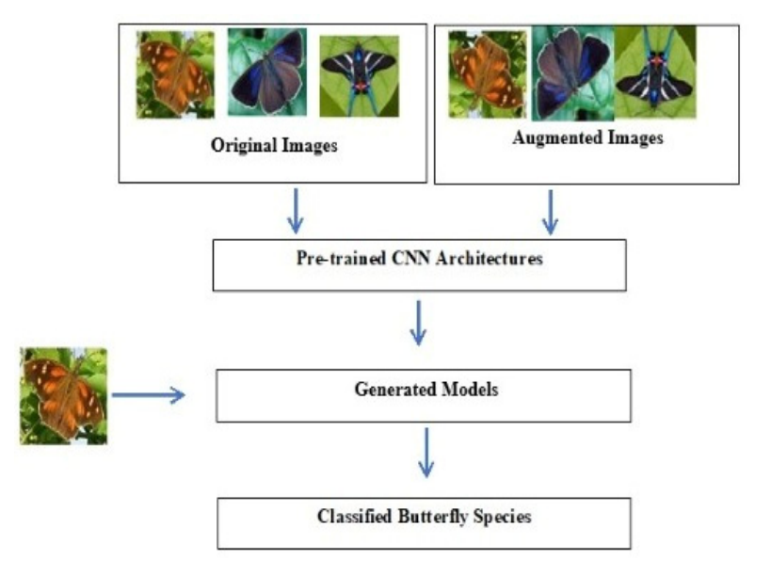
- Proposed System -
In our system we will be using CNN with ResNet 50.
ResNet 50 is a pretrained convolutional neural network model that is 50 layers deep.
We will be training the CNN with the help of transfer learning technique by using the weights of the ResNet 50 model.
We were able to achieve accuracy of 96% and it is expected to be 98% with further fine tuning.
Finally this will be made as an Web App with clean UI/ UX and additionally Open AI’s GPT will be implemented for getting the information about the predicted butterfly species.

Slide 7
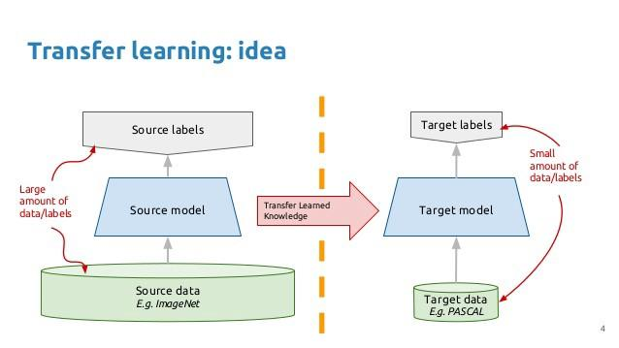
- Methodology -
Transfer Learning with CNN:
Transfer learning taking a model trained on a large dataset and transfer its knowledge to a smaller dataset.
Since this project is based on Image Classification we will be using
ResNet50 (Pre-trained model) with the
Weights of ImageNet (A very large collection of Image dataset)
Using this our CNN will be trained to achieve greater accuracy than the existing models.

Slide 8
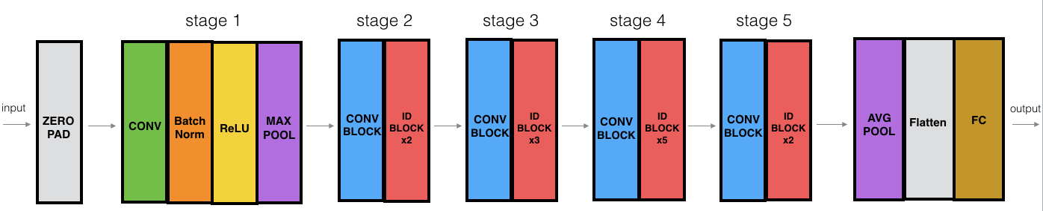
- ResNet-50 – Architecture -
1 MAX POOL LAYER
48 CONVOLUTION LAYERS
1 AVERAGE POOL LAYER

Slide 9
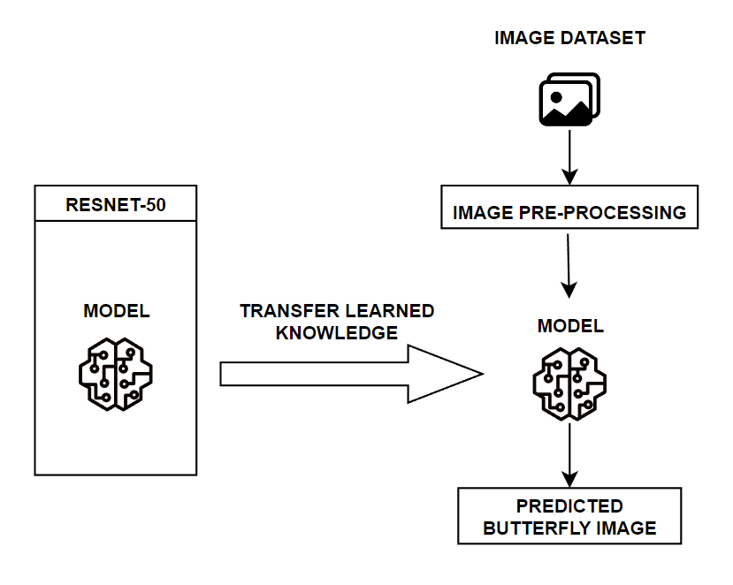
- System Architecture -

Slide 10
- Modules -
1
IMPORTING & PRE-PROCESSING DATA
2
BUILDING & TRAINING CNN WITH RESNET-50
3
EVALUATING THE ACCURACY AND LOSS
4
PREDICTING
THE TEST
IMAGES

Slide 11
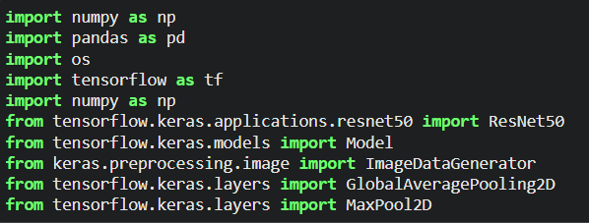
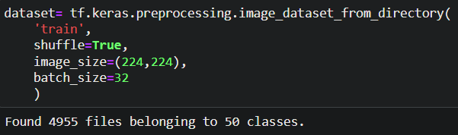
- Implementation -
1. IMPORTING & PRE-PROCESSING DATA

Slide 12
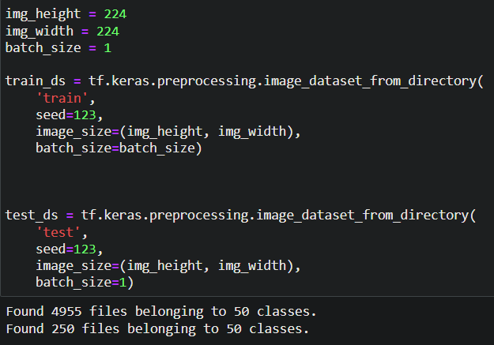

Slide 13
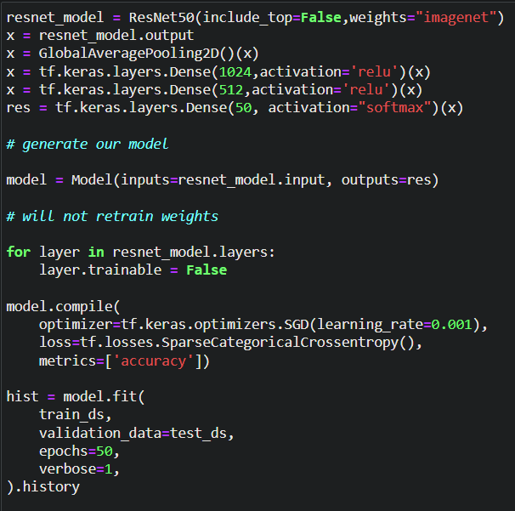
2. BUILDING & TRAINING CNN WITH RESNET-50

Slide 14
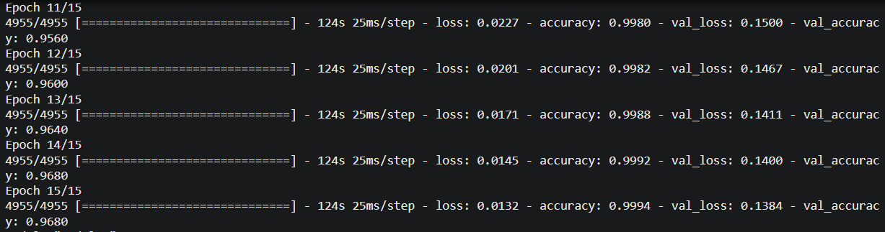
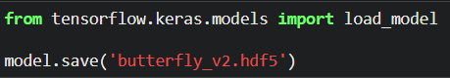
SAVING THE MODEL

Slide 15
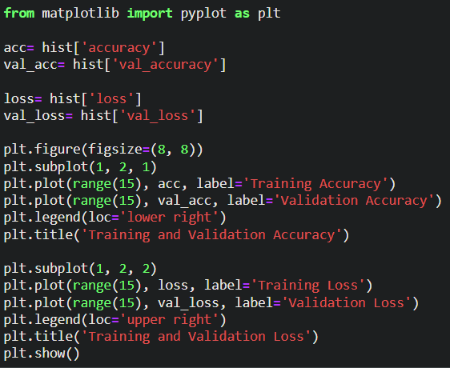
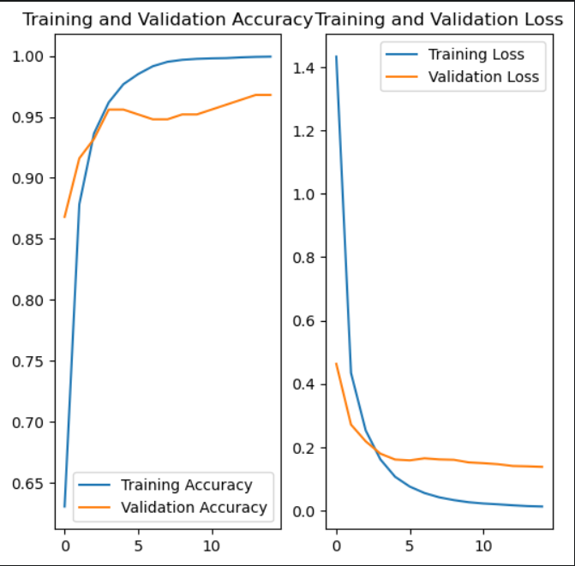
3. EVALUATING THE ACCURACY AND LOSS

Slide 16
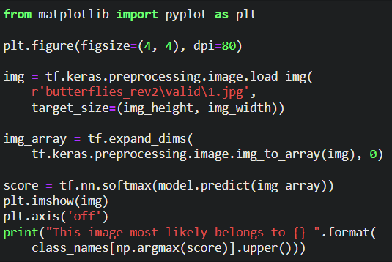
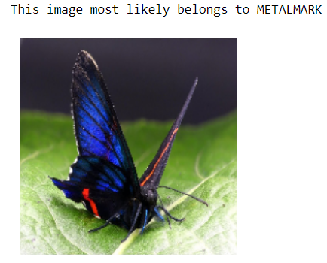
4. PREDICTING THE TEST IMAGES

Slide 17
- References -
Butterfly Image Classification Using Convolutional Neural Network (CNN)
IEEE | 2019 | DOI: 10.1109/I2CACIS.2019.8825031
Using Partial Least Squares in Butterfly Species Identification
IEEE | 2020 | DOI: 10.1109/SIBGRAPI51738.2020.00047
Classification of color features in butterflies using the Support Vector Machine (SVM)
IJCONSIST | 2021 | DOI: doi.org/10.33005/ijconsist.v2i02.50
A Novel Method for the Classification of Butterfly Species Using Pre-Trained CNN Models
MDPI | 2022 | DOI: doi.org/10.3390/electronics11132016

